Slide 1
CS544 Introduction to Network Science Measures and Metrics
Slides from Konstantinos Pelechrinis course on Network Science & Analysis, University of Pittsburgh

Slide 2
Degree centrality
Centrality is a widely studied concept
Which are the most important/central nodes in a network?
Simplest centrality metric is the degree centrality
It is simply the degree of node
For a directed network we have in- and out-degree centralities
Each one appropriate for different circumstances
Simple, yet illuminating measure
Social network → node of high degree might be though as one with access to more information sources, with more prestige etc.
Citation network → a paper with more citations (in-degree centrality) might be roughly thought as influential

Slide 3
Eigenvector centrality
Degree centrality assumes all neighbors are equal → Only the number of neighbors matter
However, in many circumstances the importance of a vertex increases if it is connected to important nodes → eigenvector centrality
Assume initially everyone has score x_{i}=1 and we update its centrality using the sum of the scores/centralities of his neighbor’s

Slide 4
Eigenvector centrality
After t updates we will have:
Expressing vector x(0) as a linear combination of the eigenvalues of A (why can we do this?) we have:
Hence: where κ₁ is the largest eigenvalue
Since all, but for i=1, the terms in the sum decay exponentially as t grows, we have for
Therefore, vector x is basically the leading eigenvector of A:
Notes:
Because A is summetric → eigenvalues orthogonal → full base of R^n
We do not care about the actual values of x, but at their ranking

Slide 5
Eigenvector centrality
As wanted the centrality x_{i} is proportional to the sum of the centralities of i’s neighbors
So the eigenvector centrality of a node can be large for two reasons
Has many neighbors and/or
Has important neighbors
Note: All eigenvector centrality values are non-negative
Notes:
Say example from social nets (someone knows many people or few but important)

Slide 6
Eigenvector centrality for directed networks
The adjacency matrix is general asymmetric → two leading eigenvectors
Which to use?
In most cases we use the right eigenvector
The centrality in most of the cases is conferred by other vertices pointing towards you
Where x is the right leading eigenvector

Slide 7
Eigenvector centrality for directed networks
What is the eigenvector centrality of A ?
Of B ?
Only vertices that are in a strongly connected component
of two or more vertices, or the out-component of such
a component can have non-zero eigenvector centrality.
In acyclic graphs eigenvector centrality is completely useless
Notes:
These are for the right eigenvector centrality

Slide 8
Katz centrality
In order to overcome problems as the above in directed networks we can tweak the eigenvector centrality and give each vertex a small amount of centrality “for free”
The first term is the normal eigenvector centrality and the second is the “free” part
By setting β=1 we have:
Katz centrality

Slide 9
Choice of α
α governs the balance between the eigenvector centrality contribution and the constant term
For small α the Katz centrality is dominated by the constant factor and hence all vertices have a centrality of 1 (β=1)
For large values of α Katz centrality diverges
As we increase α from zero the centralities increase and there comes a point at which they diverge. This happens at the point where (I-αA)⁻¹ diverges → det(I-αA)=0 → det(A-α⁻¹I) = 0
The roots α⁻¹ are equal to the eigenvalues of A
As α increases the determinant first crosses zero when α=1/κ₁, where κ₁ is the largest eigenvalue of A
Hence α should be less than 1/κ₁

Slide 10
Extension of Katz centrality
A possible extension of the above definition is to assign different constant centrality to different vertices
β_{i} is some intrinsic, non-network contribution to the centrality for each vertex
E.g., in a social network the importance of an individual might depend on non-network factors as well, such as age or income etc.

Slide 11
PageRank
One possible problem with Katz centrality is that a vertex v with high centrality and high out-degree will cause a large number of vertices to have high centrality as well
In reality though each one of the vertices that v points to should get a fraction of v’s centrality
A problem can arise when a node j has no vertices that points to
A_{ij} as well as j’s out-degree will be 0 and their ratio is not defined
However, when a node has no out edges should contribute zero to the centralities of any other vertex and hence we can artificially set this contribution to 0 by setting its out-degree to 1

Slide 12
PageRank
Hence the PageRank can be expressed as
Where D is a diagonal matrix:
Again the choice of α is important
Should be less than the inverse of the leading eigenvalue of the matrix AD⁻¹
Google search engine sets α=0.85
There is no rigorous theory behind this choice

Slide 13
PageRank
Again we can generalize PageRank
β_{i} can be possibly based on the relevance of the page/vertex with the query
With no additive constant term we get:
For an undirected network this is simply the degree centrality
For directed networks it does not reduce to a known centrality measure, but it suffers from the same problem of the original eigenvector centrality

Slide 14
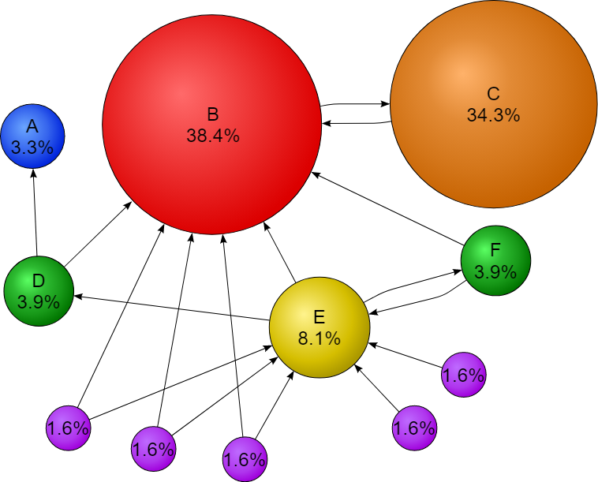
How it looks?
No node has 0 page rank

Slide 15
Centrality metrics summary

Slide 16
Hubs and authorities
For directed networks there is another twist to the centrality measures
Authorities are nodes that contain useful information on a topic of interest
Hubs are nodes that tell us where the best authorities can be found
Hyperlink-Induced Topic Search or HITS defines two types of centralities for a vertex i
Authority centrality x_{i}
Hub centrality y_{i}

Slide 17
HITS
The authority centrality of vertex i is proportional to the sum of the hub centralities of the vertices that point to i, while its hub centrality is proportional to the sum of the authority centralities of the vertices it points to
The authorities and hub centralities are the eigenvectors of AA^{T} and A^{T}A respectively with the same (leading) eigenvalue

Slide 18
HITS
The above means that AA^{T} and A^{T}A should have the same leading eigenvalue λ₁
It can be proven that in fact all the eigenvalues are the same for the two matrices
Hence A^{T}x is an eigenvector of A^{T}A with the same eigenvalue λ
Furthermore we have , which means that we only need to compute the authority centrality

Slide 19
Notes on HITS
AA^{T} is the co-citation matrix → authority centrality is roughly the eigenvector centrality of the co-citation matrix
Why roughly?
Similarly A^{T}A is the bibliographic coupling matrix → hub centrality is roughly the eigenvector centrality of the bibliographic coupling network
HITS provides an elegant solution to the problem raised from eigenvector centrality in directed networks
Notes:
Co-citation matrix is not really an adjacency matrix → diagonal elements are not zero

Slide 20
Closeness centrality
Measures the distance from the vertex to the rest of the network
If d_{ij} is the length of the shortest path between i and j, then the mean distance from i to any other node is:
Vertices that are separated by other nodes by short geodesic distances have a low l_{i} value
Not considering the summation term for j=i we get:

Slide 21
Closeness centrality
In contrast to other centrality measures, l_{i} gets smaller values for central nodes
Hence closeness centrality C_{i} is given by:
A problem with closeness centrality is that its value’s dynamic range is relative close
Small changes in the network can cause large fluctuations and ranking changes
Other centrality measures we have examined do not typically suffer from similar problems
Especially the leaders are clearly separated
Notes:
The dynamic range increases only logarithimically with the number of nodes in the network

Slide 22
Closeness centrality
A second problem with the definition arises when we have networks with more than one connected components
Nodes belonging to different components will have infinite distance, leading l_{i} to be infinite as well
One possible solution is to consider in the summation only the vertices within the same component
What is the problem with this approach?
A more elegant solution is to redefine closeness in terms of the harmonic mean distance between vertices
Notes:
Components with a few nodes only (e.g., 3) will tend to exhibit small distances between their nodes and hence higher centrality. In reality though, nodes in small disconnected components are not central participants of the network!

Slide 23
Betweenness centrality
Measures the extent to which a vertex lies on paths between other vertices
Vertices with high betweenness may have considerable influence within a network by virtue of their control over information passing between others
Removal of vertices with high betweenness will disrupt the most communications between other vertices
Formally, assume a network with at most one shortest path between any pair of vertices
Then the betweenness centrality of a vertex i is defined to be the number of those paths that pass through i

Slide 24
Betweenness centrality
Mathematically let n^{i}_{st} be 1 if vertex i lies on the shortest path between s and t, and 0 if not (or s and t belong to different components). Then the betweenness centrality of i, x_{i} is:
Since we count both paths from s to t and from t to s, the above equation can be directly applied to directed networks
We also consider paths when s=t (it does not change the ranking of nodes)
Paths from s to t are considered to pass from s and t
Again this choice does not make any change in the relevant betweenness of nodes belonging at the same component (which is what we care about)

Slide 25
Betweenness centrality
The above hold if there is at most 1 shortest path between two vertices
This is not the case though in real networks → multiple shortest paths (not necessarily vertex/edge independent)
The standard extension is to consider a weight for every shortest path between the pair (s,t)
Weight is equal to the inverse of the number of shortest paths between (s,t)
Betweenness of a vertex is then simply the sum of the weights of the shortest paths crossing this vertex

Slide 26
Betweenness centrality
Formally, we redefine n^{i}_{st} to be the number of shortest paths between s and t that pass through i, while g_{st} is the total number of shortest paths between s and t. Then:
Terms where g_{st}=0, are not considered, since this means that s and t belong to different components
Similar definitions exist for directed networks, but betweenness is rarely used in this case
6
4
5
2
3
1

Slide 27
Betweenness centrality
Betweenness centrality captures how much a vertex falls between others, in contrast with other centrality measures we have seen, which capture how well connected the node is
A vertex can have low degree/eigenvector/closeness etc. centralities but high betweenness centrality
A is a broker vertex

Slide 28
Betweenness centrality
Betweenness exhibits a large dynamic range of values
For instance consider a star topology
Largest value is n²-n+1 (why?)
Lowest value is 2n-1 (why?)
The ratio of largest to lowest is ≈(1/2)n
As network evolves betweenness values can shift but the ordering at the top of the list changes relatively infrequently

Slide 29
Normalized betweenness
Some software tools make use of a normalized version of betweenness centrality
A natural choice is to divide it with the total number of (ordered) vertex pairs:
Other choice is to divide with the maximum possible value for the betweenness (rarely used):

Slide 30
Flow betweeenness
In reality shortest paths are not always followed
E.g., think of how many times you have heard some news about a friend of yours not from him/her directly but from a third person
Flow betweenness makes some allowances for effects like this
Relevance with maximum flow
Is defined from the same equation but now n^{i}_{st} is the amount of flow through vertex i when the max flow is transmitted from s to t
From Menger’s theorem, n^{i}_{st} is the number of edge independent paths between s and t that pass through i

Slide 31
Flow betweenness
The edge independent paths are not necessarily unique
Some vertices might be part of one maximal set of edge independent paths but not of others
Freeman et al. define the flow through
a vertex, such as A, to be the maximum
possible flow over all possible choices
of paths
Hence, in the topology presented the flow between s and t would contribute 1 to the centrality of A
Notes:
In other words it is the maximum possible number of edge independent paths going through the node

Slide 32
Random-walk betweenness
Flow centrality might miss shortest paths at all
Hence, no matter which definition we are using from the ones presented we might not consider important paths for different reasons
Random-walk betweenness aims at counting all paths
Traffic between s and t is thought as following a random-walk with absorbing state (state t)
n^{i}_{st} is the number of times that the random walk from s to t passed through node i averaged over many repetitions of the walk

Slide 33
Random-walk betweenness
Random-walk betweenness captures the betweenness centrality of a vertex in a network where information wonders around in the network at random
On the opposite extreme shortest path betweenness captures the centrality when information flows over a known path
The truth is a real network should lay somewhere in between…
S.P. Borgatti, “Centrality and Network Flow”,
Social Networks 27, 55-71 (2005)

Slide 34
Groups of vertices (Social Cohesion)
Clique is a maximal subset of the vertices in an undirected network such that every member of the set is connected by an edge to any other vertex
Cliques can overlap → they can share one or more vertices
A clique in an otherwise sparse network, indicates a highly cohesive subgroup
The requirement of being connected to all other members is strict
In real networks, people might be connected to most but not all of their acquaintances

Slide 35
k-plex
k-plex of size n is a maximal subset of n vertices within a network such that each vertex is connected (by an edge) to at least n-k of the others
For k=1 we have the ordinary cliques
Similar to cliques k-plexes can be overlapping
k-plexes is a useful concept on social network analysis but there is no solid rule what value k should take
Another generalization of cliques (and k-plexes) is one where we could specify that each member should be connected to a fraction of the others (e.g., 50% or 75% etc.)

Slide 36
k-core
Maximal subset of vertices such that each is connected (by an edge) to at least k others in the subset
The total number of nodes in the core is not restricted
Hence, the set of k-cores is not the same with the set of k-plexes for a given value of k
A k-core of size n is also a (n-k)-plex
Two k-cores cannot overlap, since then they would just form another k-core of larger size (maximal subset)

Slide 37
k-core
k-cores are of particular interest since there are straightforward algorithms to compute k-cores in a network:
Start by removing from the network nodes of degree < k
Remove also edges of these nodes → update the degrees of nodes that remained after pruning
Continue this process iteratively until you cannot remove any other nodes
The remaining nodes form one or more k-cores
The resulting k-cores might not be connected, regardless if the network we started with was connected or not

Slide 38
k-cliques and k-clans (k-clubs)
k-clique is a maximal subset of vertices such that each is no more than a distance k away from any of the others via the edges of the network
For k=1 this just recovers ordinary cliques
The paths through which the members of a k-clique are connected, not need to be consisted of vertices within the group
If we restrict to paths that run only within the subset then we obtain k-clans or k-clubs
Notes:
Check the social network analysis book from Wasserman and Faust for details

Slide 39
k-components
A k-component is a maximal subset of vertices such that each is reachable from each of the others by at least k vertex-independent paths
For k=2 → bicomponents and for k=3 → tricomponents
A k-component is a subset of a (k-1)-component

Slide 40
k-components
k-components are tightly related with the notion of network robustness
For k>2 the k-components need not be contiguous
In social network sciences non-contigu-
ous components are not desirable
A more strict definition comes from the
requirement that the paths should be entirely
within the subset

Slide 41
Transitivity
Transitivity is important in social networks
Not that much in other types of networks
A relation ° is transitive if
The most simple – but also important – relation in a social network is “connected by an edge”
If vertex u is connected by an edge with v, and v is connected by an edge with w, then u is connected by an edge with w
Perfect transitivity only occurs in networks where each component is a fully connected subgraph or clique

Slide 42
Transitivity
Partial transitivity can be also useful
The fact that u knows v and v knows w, does not mean that u must know w
However, it increases the probability that u knows w
Clustering coefficient (cc) is used to capture this partial transitivity
The above definition is for the network as a whole
A high clustering coefficient is translated to a network with high transitivity
People belong to tight groups
Notes:
Paths are counted in both ways; uvw is different than wvu

Slide 43
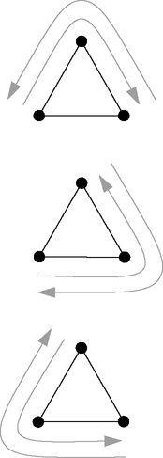
Transitivity
Another way to compute the above expression is by counting the number of triangles that appear in the network
Every triangle contains 6 paths of length two and hence:
Alternatively, a connected triplet can be defined as
a set of three nodes uvw with edges (u,v) and (v,w):

Slide 44
Clustering coefficient in directed networks
In a directed network, traditionally cc is computed by assuming no direction on the edges
There are extensions that consider edge direction
E.g., if “u points/likes v” and “v points/likes w”, then “u points/likes w”
These extensions have not found a widespread application in the literature

Slide 45
Local clustering
As we said clustering coefficient can be defined for a single vertex as well:
If we find the average clustering coefficient from all vertices of a network, we practically have the clustering coefficient of the network
Clustering coefficient is closely related with structural holes

Slide 46
Structural holes
While it is common for the neighbors of a vertex to be connected among themselves, it happens sometimes that these expected connections between neighbors are missing
These missing links are called structural holes
Structural holes can be a bad thing with regards
to efficient spread of information
Information has fewer routes to move around
They are good though for the vertex i
Hence, local clustering coefficient could be a measure of possible influence of the specific vertex (lower value is better)
Notes:
Local cc is a local version of betweenness centarlity. Betweenness is more computational coslty. Given also that it has been shown that there exists a strong corelation betwee local cc and betweenness, it might be too little to gain from computing the global version of this kind of centrality (betweenness)

Slide 47
Redundancy
The redundancy R_{i} of a vertex i is the mean number of connections from a neighbor of i to other neighbors of i
R_{i}=1/4(0+1+1+2)=1
Redundancy for a node i takes values from 0 to k_{i}-1
R_{i} is closely related with CC_{i}
When the average connections of a friend of i with the other friends of i is R_{i}, the total number of such edged is ½(k_{i}R_{i})
The total number of possible such edges is ½k_{i}( k_{i}-1)
Hence:

Slide 48
Local VS Global clustering coefficient
Watts and Strogatz have suggested computing the clustering coefficient of a network as the average over all the local clustering coefficients of the vertices:
NOTE: This definition gives different result than the previous one on global cc
The above definition tends to give high cc values for networks dominated by vertices of low degree (why?) – which is regularly the case in real networks

Slide 49
What value for cc is high?
1/(2*1/2)=1
2/(3*2/2)=2/3
3/(4*3/2)=1/2
2/(3*2/2)=2/3
1/(2*1/2)=1
CC=(1+1/2+1+2/3+2/3)/5=0.7666…

Slide 50
What value is high?
The notion of high clustering coefficient is relevant
We define the edge density p of a network as:
If we pick a pair of vertices at random, the probability that they are connected is p
If we pick a pair of vertices with a common connection at random, then the probability that they are connected is C
Hence if C >> p, we say that the network has a high clustering coefficient
So is the cc high in the previous network?
Notes:
* This is essentially comparing with a Poissonian random graph – It might not be a correct comparison for real networks that follow different (not Poisson) degree distribution

Slide 51
Reciprocity
The cc is examining loops of length 3 – this is the smallest possible loop size in an undirected network
However, in directed networks there can be loops of size 2
Reciprocity measures the frequency of length
2 loops in a directed network
If there is a directed edge from i to j and there is also an edge from j to i then we say that the edge (i,j) – or the edge (j,i) – is reciprocated

Slide 52
Reciprocity
Formally, reciprocity is defined as the fraction of edges that are reciprocated
A_{ij}A_{ji} is one iff both edges (i,j) and (j,i) exist
In other iff (i,j) is reciprocated
Hence, if m is the total number of directed edges:
What is the reciprocity
in this network?
Notes:
4/7

Slide 53
Signed edges
In social networks, edges can be annotated as positive or negative
Positive → Friends
Negative → Enemies
Note that a negative edge represents people who interact, but in a negative way
It is not the same with the absence of an edge
A network with positive and negative labels on its edges is called signed network
The corresponding edges are called signed edges

Slide 54
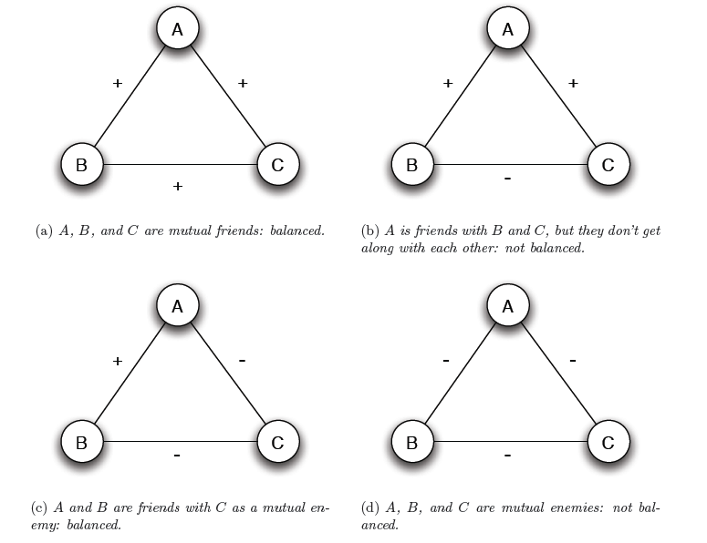
Structural balance
Triangles with 1 or 3 ‘+’s are balanced.
Triangles with 0 or 2 ‘+’ are unbalanced.
Notes:
Actually, it has been found from social scientists through surveys that the unstable configurations appear far less times in real social networks

Slide 55
Structural balance
Networks containing only loops with even number of minus signs are said to show structural balance
This is also true for loops of length greater than three
A balanced network can be divided into connected groups of vertices such that all connections between members of the same group are positive and all connections between members of different groups are negative
Groups can consist even of a single node
A network that can be divided into groups as per the above theorem are called clusterable
Hence, a balanced network is clusterable as well

Slide 56
Proof of the structural balance theorem
We will prove it for complete graphs (2 groups X and Y)
Extension to not connected graphs is trivial
Consider a random node A
Every node is either a friend of A (+) or its enemy (-)
Hence, natural candidates for “clusters” are:
Set X of A’s friends
Set Y of A’s enemies
We must show:
Every two nodes in X are friends
Every two nodes in Y are friends
Every node in X is an enemy with every node in Y

Slide 57
Proof of structural balance theorem
For A we know he is friend with any other person in X
What about B and C?
Since each edge (A,B) and (A,C) is +, the edge (B,C) needs to be (+) as well
Otherwise the assumption for a balanced network would not hold

Slide 58
Proof of structural balance theorem
What about nodes in Y? Are they friends?
D and E are enemies (-) with A
Hence, (D,E) must be +, otherwise the balance assumption does not hold

Slide 59
Proof of structural balance theorem
What about cross-set edges?
E.g., (B,D)

Slide 60
Note
The structural balance theorem states that a balanced network is clusterable
The opposite is NOT true
We can cluster the network in 3 clusters
However, the network is not balanced

Slide 61
Similarity
A central concept in social network analysis is that of vertex similarity
While similarity between vertices can be defined based on attributes of the vertices, we will focus on determining similarity using the information contained in the network structure
Structural equivalence
Cosine similarity, Pearson coefficients
Regular equivalence

Slide 62
Cosine similarity
A simple and straightforward metric for structural equivalence between nodes i and j, would be to measure the number of common neighbors:
However, what is a high value for n?
We need to somehow normalize this quantity
Normalizing by the total number of possible edges in the network is not good (why?)
Cosine similarity inspired by geometry
The inner product of two vectors x and y is given by:
Notes:
Nodes with low degree are bound to low similarities

Slide 63
Cosine similarity
Rearranging we have:
Considering as the two vectors the i-th and j-th rows (or columns) of the adjacency matrix we get the cosine similarity of the two vertices:
Therefore, the cosine similarity normalizes the number of common neighbors by the geometric mean of the degrees of the nodes
Notes:
If degree is zero → we conventionally say that similarity is zero

Slide 64
Pearson coefficients
The main idea is to compare the number of common neighbors between two vertices with what we should expect if connections were made at random
If the degrees of vertices i and j are k_{i} and k_{j} respectively, then if connections were made at random the expected number of common neighbors is: k_{i}k_{j}/n
A reasonable metric is then the difference between the actual number of common neighbors and the expected one

Slide 65
Pearson coefficients
The above quantity is positive if i and j have more neighbors as expected at random
We further normalize the above quantity with the maximum value of the covariance between the i-th and j-th row of the adjacency matrix
This is the variance of i-th or j-th row (they are both equal)
Notes:
Pearson coefficient takes values between -1 and 1 and allows us to say when vertices are both similar or dissimilar compared with what we would expect if connections in the network were formed at random

Slide 66
Other metrics of structural equivalence
We can normalize the number of common neighbors not by subtracting the expected number but by dividing
Euclidian distance
Dissimilarity measure
We can normalize it by the maximum possible distance (all neighbors of i and j are different)

Slide 67
Regular equivalence
Two vertices are regular equivalent if they have neighbors who themselves are similar
Metrics for regular equivalence are less developed
i and j can be considered similar if they have neighbors k and l that are similar
This expression does not necessarily give high values to “self-similarity”, and hence, to nodes that have a lot of common neighbors

Slide 68
Regular equivalence
We can fix the above issue by adding a diagonal term:
The above expression still has problems
Assuming a null matrix as the initial value of the similarity matrix and iterating we get after k iterations:
This measure of similarity is a weighted sum over the numbers of paths of even length between pairs of vertices
Why though only even length paths ?

Slide 69
Regular equivalence
New definition: Vertices i and j are similar, if i
has a neighbor k that is itself similar to j:
Iterating again starting with σ=0, we get:
The similarity of two nodes is basically the weighted sum of the number of the paths of different length that connected them
When α<1, longer paths have smaller weight
Notes:
Mention the similarity with Katz centrality → One could calculate the Katz similarity for the pairs of vertices and then calculate the Katz centrality of a vertex as the sum of the Katz similarity of this vertex with all the rest
Also mention that this type of regular equivalence is a generalization of the structural equivalence that measures the number of common neighbors, which is basically the paths of length 2 that connects the nodes
Also the definition is not obviously symmetric for i and j, but does in fact give rise to a symmetric similarity measure

Slide 70
Regular equivalence
The definition above inherently gives high similarity value to nodes with high degree (the summation includes more non-zero terms)
Hence, in order to avoid this bias which is not always wanted we can divide with the degree of the node:
Another variations could force the additive term δ_{ij} have non-diagonal elements as well
Nodes might have similarity based on other (non-network) information

Slide 71
Homophily and assortative mixing
People tend to associate with others whom they perceive as being similar to themselves in some ways
Homophily or assortative mixing
Figure presents the friendships in a high school
Nodes are annotated with regards to their race
Disassortative mixing is also
possible
E.g., sexual partnerships
Notes:
Assortative mixing is also present in non-social networks → e.g., citation network where papers tend to cite papers from the very same field

Slide 72
Enumerative characteristics
Consider a network where each vertex is classified according to a discrete characteristic, that can take a finite number of values
E.g., race, nationality, etc.
We find the number of edges that run between vertices of the same type and we subtract it from the fraction of such edges that we would expect to find if edges where placed at random (i.e., without regard for the vertex type)
If the result is significantly positive → assortativity mixing is present
If the result is significantly negative → disassortativity mixing is present
Notes:
Talk about trivial similarity (humans connected to humans – e.g., groups with a single type)

Slide 73
Enumerative characteristics
Let c_{i} be the class of vertex i and let n_{c} possible classes
The total number of edges connecting two vertices belonging to the same class is given by:
The expected number of edges between same type vertices is given by:
Taking the difference of the above quantities we get:

Slide 74
Enumerative characteristics
Conventionally we calculate the fraction of such edges, which is called modularity Q:
It is strictly less than 1 and takes positive values when there are more edges between vertices of the same type than we would expect
The summation term above appears in many other situations and we define it to be the modularity matrix B:

Slide 75
Enumerative characteristics
The value of Q can be considerably lower than 1 even for perfectly mixed networks
Depends on group size, degrees etc.
How can we decide whether a modularity value is large or not?
We normalize the modularity value Q, by the maximum value that it can get
Perfect mixing is when all edges fall between vertices of the same type
Then, the assortativity coefficient is given by:
Notes:
The coefficient takes value of 1 for a perfectly mixed network – however, it is not very oftenly used as compared to Q

Slide 76
Enumerative characteristics
The above equations might be computationally prohibitive to be used in large networks to compute modularity Q
Let be the fraction of edges that join vertices of type r to vertices of type s
Let be the fraction of edges attached to vertices of type r
We further have

Slide 77
Enumerative characteristics

Slide 78
Scalar characteristics
Scalar characteristics take values that come in particular order and can in theory take an infinite number of values
E.g., age
In this case two people can be considered similar if they are born the same day or within a year or within 2 years etc.
When we consider scalar characteristics we basically have an approximate notion of similarity between connected vertices
There is no approximate similarity when we talk for enumerative characteristics

Slide 79
Scalar characteristics

Slide 80
Scalar characteristics
Simple solution would be to quantize/bin scalar values
Treat vertices that fall in the same bin as exactly same
Apply modularity metric for enumerative characteristics
The above misses much of the point of scalar characteristics
Why two vertices that fall at the same bin are same ?
Why two vertices that fall in different bins are different ?

Slide 81
Scalar characteristics
x_{i} is the value of the scalar characteristic of vertex i
If X_{i} is the variable describing the characteristic at vertex i and X_{j} is the one for vertex j, then we want to calculate the covariance of these two variables over the edges of the graph
First we need to compute the mean value of x_{i} at the end i of an edge:

Slide 82
Scalar characteristics
Hence, the covariance is:
If the covariance is positive, we have assortativity mixing, otherwise we have disassortativity
As with the modularity Q we need to normalize the above value so as it gets the value of 1 for a perfectly mixed network
All edges fall between vertices that have the same value x_{i} (highly unlikely in a real network)

Slide 83
Scalar characteristics
Setting x_{i}=x_{j} for all the existing edges (i,j) we get the maximum possible value (which is the variance of the variable):
Then the assortativity coefficient r is defined as:
r=1→Perfectly assortative network
r=-1→Perfecrtly disassortative network
r=0→no (linear) correlation
Notes:
Mention about vector assortativity mixing

Slide 84
Assortative mixing by degree
A special case is when the characteristic of interest is the degree of the node
In this case studying of assortative mixing will show if high/low-degree nodes connect with other high/low-degree nodes or not
Perfectly mixed networks by degree → core/periphery
Disassortative networks by degree → uniform
Star like topology

Slide 85
Assortative mixing by degree
Assortative mixing by degree requires only structural information for the network
No knowledge for any other attributes is required

